Slide 1
Instruction Sets: Addressing Modes and Formats
Abdullah, Ibrahim
Ali, Javeed
Budhram, Dharmendra
Galiana, Thomas
Monegro, Wesley
Silva, Frank

Slide 2
11.1 Addressing
Abdullah, Ibrahim
Budhram, Dharmendra

Slide 3
Addressing Modes
Addressing mode:
it is a way to represent the address of the data.
Addressing modes:
Immediate
Direct
Indirect
Register
Register indirect
Displacement
Stack

Slide 4
Immediate
The Actual data is stored as an operand in an instruction
Mostly used to initial variables or constants
Operand = Data
Instruction
Opcode
Operand
Advantage | Disadvantage
No memory referencing | Inflexible
Fast processing | Limited size
Simple

Slide 5
Direct
The operand contain the address of Data in the memory
EA = A
Operand = Address
Address → Data
Advantage | Disadvantage
Simple | Limited addressing range (operand size)
Takes only one memory cycle | Not common
No calculation required

Slide 6
Direct
Instruction
Opcode
Address A
Memory
Operand

Slide 7
Indirect
EA = (A)
Operand = address1
Address 1→ Address2
Address2 → Data
Advantage | Disadvantage
Large Addressing Range 2^N (N word length) | Many memory cycles required
It solve the limitation of Direct

Slide 8
Indirect Diagram
Instruction
Opcode
Address A
Memory
Pointer to operand
Operand

Slide 9
Register
EA = R
Operand = Register number
Register = Data
Advantage | Disadvantage
No Memory reference required | Limited address range (no of available registers)
Usually use 3-5 bits to address a register
Faster than direct

Slide 10
Register Diagram
Instruction
Opcode
Register Address R
Registers
Operand
EA = R
Operand = address
Register = Data

Slide 11
Register Indirect
EA = (R)
Operand = register number
Register = Address
Address →Data
Advantage | Disadvantage
Large address space | Extra memory cycles
Faster than indirect

Slide 12
Register Indirect
Instruction
Opcode
Register Address R
Memory
Registers
Pointer to Operand
Operand

Slide 13
Displacement
EA = A (displacement Address)+ (R) (main address)
Operand = D-Address , R
R = main Address
Main Address + D-address →Data
It combines Direct and Register indirect modes
Most common uses :
Relative Addressing.
Index-Base
Register indexing.
Advantage | Disadvantage
Very powerful | Need calculation
Flexible | Complexity
Limited to 2^k ( k Address length) | Limited uses to N register

Slide 14
Displacement Diagram
Instruction
Opcode
Register R
Address A
Memory
Registers
Pointer to Operand
+
Operand

Slide 15
Displacement : Relative Addressing
PC contains the main address
EA = PC+ D-address
Operand = D-address
PC + D-address = Data

Slide 16
Displacement: Base-register Addressing
A register contains the main address field
The operand contain the displacement address
It can be used
explicitly (referenced by the instruction)
Or
implicitly for e.g : segments register in X86

Slide 17
Displacement: Indexing
The Address field references a main address in the memory and the register references a positive displacement
Similar to Base – register mode , but the opposite.

Slide 18
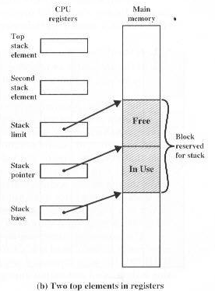
Stack Addressing mode
Similar to Register indirect mode
Operand = <none>
Stack pointer - 1→ Address
Address → data

Slide 19
11.2 x86 Segment Registers x86 Addressing Modes
Galiana, Thomas
Silva, Frank

Slide 20
Preliminary
x86 is the family of instruction set architectures based on the Intel 8086
This introduced the innovative method of segmentation

Slide 21
x86 Segment Registers
Problem: 1 MB of memory space needed addressing (20 address lines); impractical to create a 20 bit register
Solution: divide memory into 64 KB segments and coordinate access using two 16 bit values (offset and segment).
Two modes: Real and Protected; real: linear address is equal to the physical address; protected: the linear address space is different (variable) and the CPU performs address calculations transparent to the programmer.

Slide 22
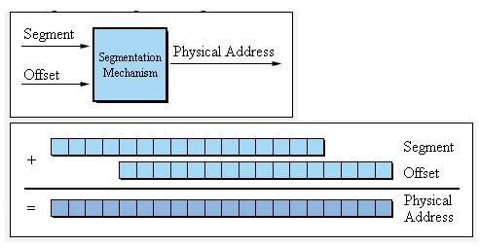
x86 Segment Registers

Slide 23
x86 Segment Registers
Segment: 16-bit value identifies a specific 64KB region of memory
Offset: 16-bit value which identifies an exact point within the region
Physical address: segment value is shifted 4 bits to the left then added with the offset to calculate the physical address

Slide 24
x86 Segment Registers
There are six segment registers in the x86.
  the one being used depends on the context of execution and instruction
Originally in the 8086: CS, SS, DS, ES
Added in the 32-bit architecture: FS, GS

Slide 25
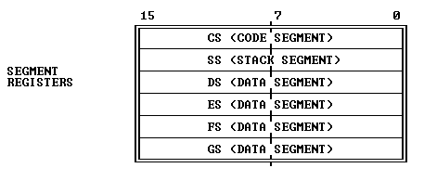
x86 Segment Registers

Slide 26
x86 Segment Registers
Code Segment Register (CS): it is the base location of the code section and is used to fetch instructions.
Data Segment Register (DS): it is the default location for variables and is used for data access.

Slide 27
x86 Segment Registers
Stack Segment Register (SS): it is the base location of stack segment.
Extra Segment Registers (ES, FS, GS): available for far pointer addressing such as video memory, etc.
A programmer has to make sure that the allocated memory segment does not overlap (ex. Data with code). This is done by wisely designating memory segments.

Slide 28
x86 Addressing Modes
Mode | Algorithm
Immediate | Operand = A
Register Operand | LA = R
Displacement | LA = (SR) + A
Base | LA = (SR) + (B)
Base with Displacement | LA = (SR) + (B) + A
Scaled Index with Displacement | LA = (SR) + (I) x S + A
Base with Index and Displacement | LA = (SR) + (B) + (I) + A
Base with Scaled Index and Displacement | LA = (SR) + (I) x S + (B) + A
Relative | LA = (PC) + A

Slide 29
x86 Addressing Modes
LA = linear address
(X) = contents of x
SR = segment register
PC = program counter
A = contents of an address field in the instruction
R = register
B = Base register
I = index register
S = scaling factor

Slide 30
x86 Addressing Modes
Immediate: the operand is included in the instruction.
Register Operand: the operand is located in a register.
Displacement: the operand’s offset is contained as a part of the instruction as an 8-, 16-, or 32-bit displacement.

Slide 31
x86 Addressing Modes
Base: specifies one of the 8-, 16-, 32-bit registers contains the effective address (register indirect addressing).
Base with Displacement: the instruction includes a displacement to be added to a base register.
Scaled Index with Displacement: the instruction includes a displacement to be added to a register (index register).

Slide 32
x86 Addressing Modes
Base with Index and Displacement: sums the contents of the base register, the index register, and a displacement to form the effective address.
Based Scaled Index with Displacement: sums the contents of the index register multiplied by a scaling factor, the contents of the base register, and the displacement.

Slide 33
x86 Addressing Modes
Relative: can be used in transfer-of-control instructions. A displacement is added to the value of the program counter, which either increases or decreases the address in the program counter.

Slide 34
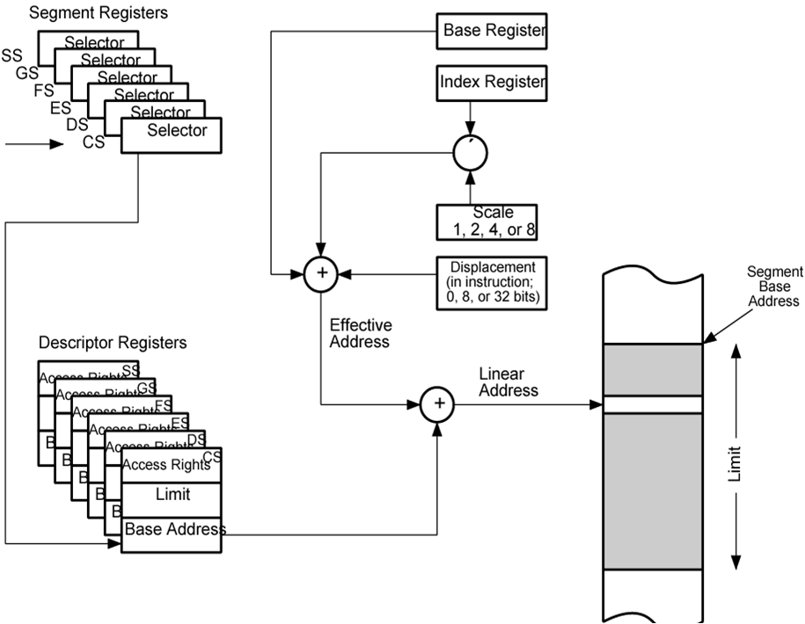
x86 Addressing Modes
x86 Addressing Mode Calculation

Slide 35
11.3 Instruction Formats
Ali, Javeed
Monegro, Wesley

Slide 36
Instruction Format
Instruction Format: The layout of bits of an instruction inherent to its execution.
Made up of an opcode and zero or more operands.
Regardless of the format, the design must indicate the required addressing mode.

Slide 37
Instruction Length
Greatest design issue lies in instruction length
    Speed and ease of use v. Space and cost
    i.e. a 64-bit instruction occupies 2x the space of a 32-bit instruction with less than half the utility.
Determines:
    Memory Size
    Memory Organization
    Bus Structure
    Processor Complexity
    Processor Speed

Slide 38
Instruction Length
Ideally,
  instruction length = memory transfer length
    (this is done in order to retrieve an integral number of instructions per fetch cycle)
  instruction length is a multiple of character length.
    This prevents having to bridge a word boundary.
Memory transfer rate
  Not on par with increases in processor speed today.
  Must be considered to avoid having the processor execute instructions faster than it can fetch them.

Slide 39
Allocation of Bits
Opcode length v. Operand and addressing length.
    More opcodes mean more opcode bits and less bits available for addressing.
Factors used in determining use of addressing bits include:
  Number of addressing modes
    Implicitly or explicitly (i.e. 18-bit pre-byte implicitly used for indexed addressing mode)

Slide 40
Allocation of Bits
  Number of Operands
    Typically 2 operands, as the longer the operand size the longer and more awkward the program.
    Mode Indicators
  Register v. Memory
    Single-register programming
      No instruction bits required to determine which user-visible register is to be used.
      Slower, requires more instructions.
    Multiple-register programming
      Several bits in Operand portion of the instruction require fewer bits overall.

Slide 41
Allocation of Bits
  Number of register sets
    Typically 32 registers in one set.
    Using two or more specialized sets requires fewer bits to identify a register within the instruction. (i.e. Data set, Displacement set or as seen in the x86)
  Address Range
    Range of addresses referenced depends on the number of address bits.
    Direct v. displacement addressing
      Using displacement, the range is then open to the length of the address register instead of the instruction address length.

Slide 42
Allocation of Bits
  Address Granularity
    Granularity: The extent to which a system contains separate components. The greater the granularity the more flexible the system is.
    Designer’s choice
      Address can reference 16-, 32-bit words.
      Less granularity requires more address bits.

Slide 43
PDP-8
One of the historically more simple machine designs.
  12-bit instructions
  12-bit words
  Single register programming
    Accumulator
  Two 1-bit modifiers
    Referring to page 0 or current page.
    or whether Direct/Indirect addressing is to be used.
  3-bit Opcode with instructions 0-5 using basic format
    Opcode 6 is an input/output instruction
      6 bits select one of 64 devices and remaining 3 specify command
    Opcode 7 is a register reference instruction including three microinstrunction groups embedded with single bit operations.

Slide 44
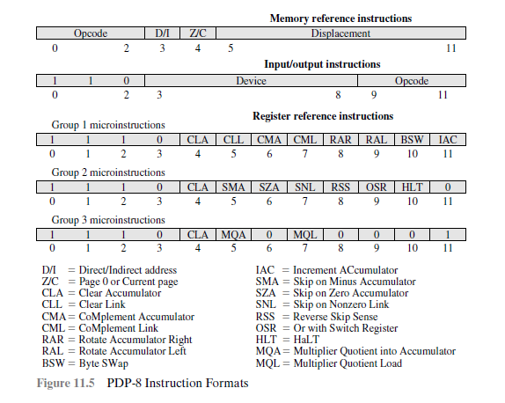
PDP-8
Simple yet efficient, the PDP-8 supports indirect, displacement, and indexed addressing with a total of 35 instructions.

Slide 45
PDP-10
Opposite to PDP-8 with emphasis on ease of use yet inefficient use of space. Its design is based on:
  Orthogonality, or the principle by which two variables are independent of each other.
    i.e. PDP-10 address is always computed in the same way, independent of the opcode.
  Completeness
    Each data type has an identical set of operations.
  Direct addressing is used again for ease of programming.

Slide 46
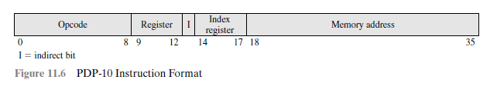
PDP-10
36-bit word length
36-bit instruction length
9-bit opcode
    Allows for directly defined instructions
16 general registers
    Indirection bits used for memory locations above 2¹⁸

Slide 47
Variable Length Instructions
Uses different varieties of instruction lengths to allow for greater efficiency while using less space.
  This does however increase complexity.
PDP-11
  Eight 16-bit registers
    Two used as a stack pointer and program counter
  Uses 13 different formats
    Opcodes vary from 4 to 16-bits in length
  Increased hardware cost and complexity v. efficiency

Slide 48
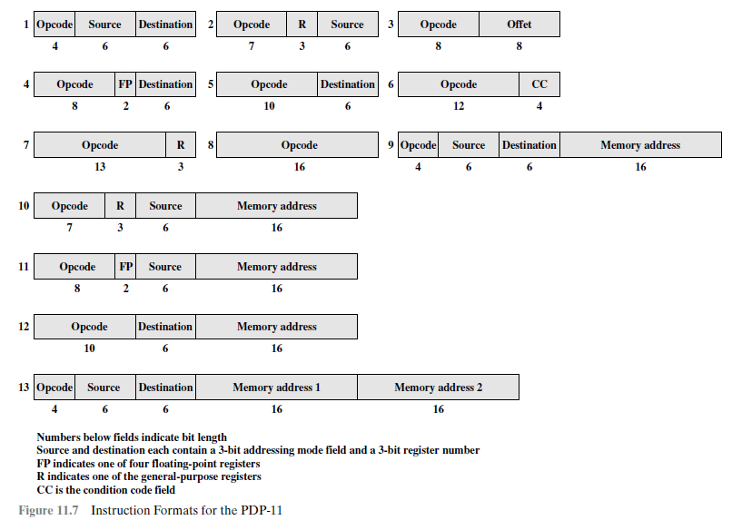
Variable Length Instructions

Slide 49
VAX
Instruction set format designed by Digital Equipment Corporation (DEC) mid 1970s.
Virtual Address eXtenstion
Instructions either consist of a 1 or 2-byte opcode followed by from 0-6 operand specifiers.
  Very flexible yet increasingly complex

Slide 50
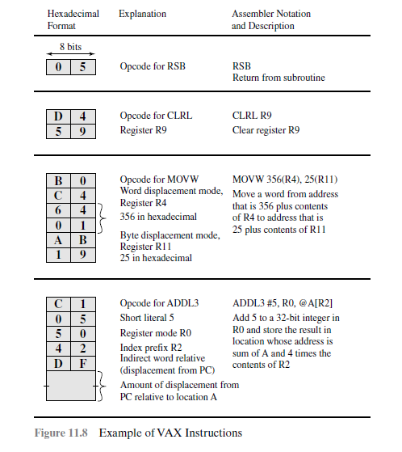
VAX

Slide 51
Questions
What are addressing modes?
In the x86, how is the physical address calculated?
How is the instruction determined in the x86 base with displacement addressing mode?
What is the greatest variable when designing an instruction format?
Would a fixed-length instruction be easier to use as a programmer over a variable-length instruction?

Slide 52
Questions
Which 16-bit value determines a region of memory in the x86?
Which are the fastest and slowest addressing modes?
Which addressing mode implicitly defines itself apart from its opcode?
Which is the most flexible addressing mode?
What are the most common uses of the displacement addressing mode?

Slide 53
Answers
A way to represent a memory address. A way to address the data.
By adding the segment base and the effective address (offset).
The instruction includes a displacement to be added to a base register. (Segment register + base register + address field in the instruction).
Instruction length.
Fixed-length instructions are more programmer friendly as variable-length instructions can become increasingly complex.

Slide 54
Answers
Segment
The fastest addressing mode is Immediate whereas the slowest is Displacement.
Indexed (18-bit prebyte)
Indirect and Direct together or Displacement.
Relative, base register, indexing

Slide 55
Works Cited
http://en.wikipedia.org/wiki/X86
http://www.altera.com/literature/third-party/archives/ddi0100e_arm_arm.pdf
http://home.comcast.net/~fbui/intel.html
http://www.programming.msjc.edu/asm/Unit2/x86MemoryManagement.aspx
http://www.tenouk.com/Bufferoverflowc/Bufferoverflow1a.html
http://www.eecg.toronto.edu/~amza/www.mindsec.com/files/x86regs.html
http://en.wikipedia.org/wiki/ARM_architecture
http://www.webopedia.com/TERM/G/granularity.html
http://en.wikipedia.org/wiki/VAX
Computer Organization and Architecture, 8th Edition, by William Stallings

